Slide 1

BlockChain Developer Project
Jwellery Store

Slide 2
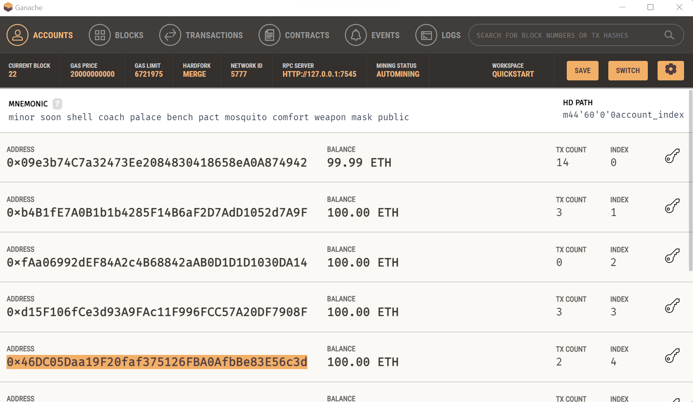
EVM Setup with Ganache

Slide 3
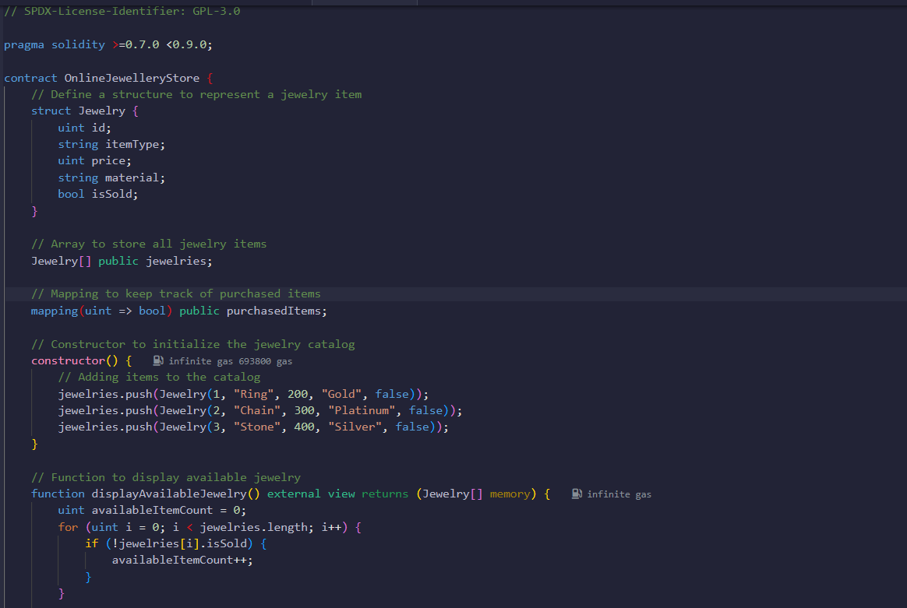
Smart Contract Information
Jwellery Store

Slide 4
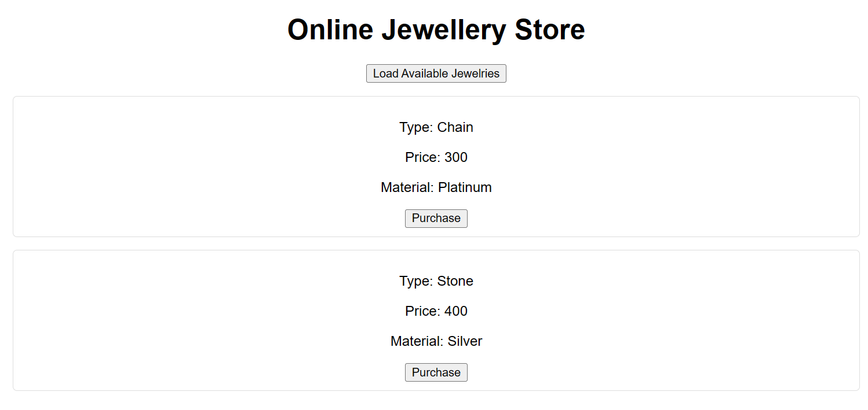
Jwellery Form Setup

Slide 5
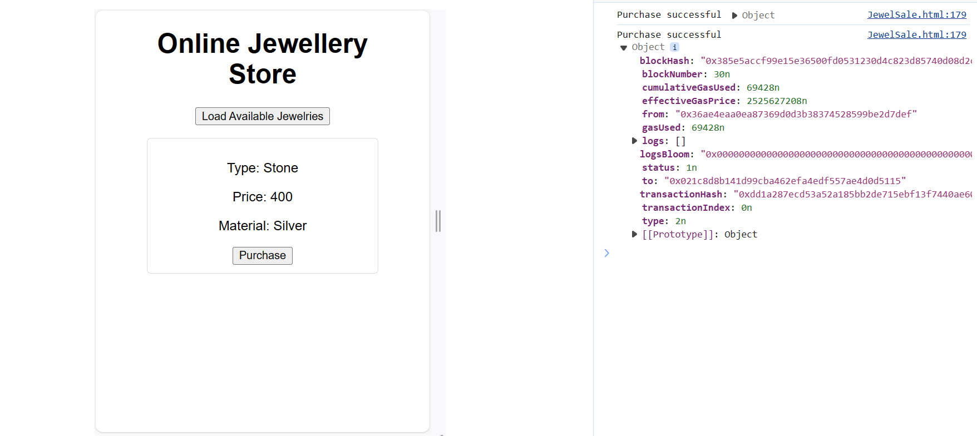
Jwellery purchase

